Slide 1



Book-Management-System: An Easy Solution
Python Mini Project
Arya Nair – 16010421063
Hiral Patel – 16010421071
Chinmay Maitre – 16010421053

Slide 2

Problem Statement and Objective
Create a Graphical User Interface (GUI) using Tkinter – Standard Python Interface, to handle a Book-Management-System.
The system should be functioning as to accept user input to save book name with its details like its author and year of publishment.
The system can store, view, add and delete the records of the books being entered making it really accessible to handle numerous books at a time and saving all the data using a viable database than notebooks using pen and paper.

Slide 3

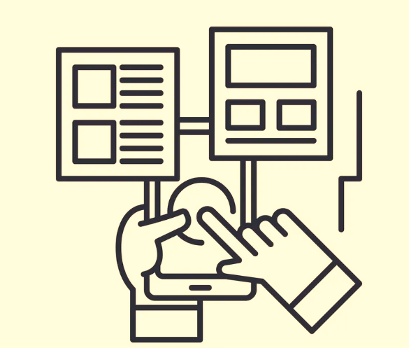



System Architecture
User Window
User Input
Validation of data
SQL database

Slide 4
Working of the System
When we access and run the code, a frontend window pops up which was made with the help of using Tkinter, the page technically asks for the user to input the title, year, author’s name and the price of the book.
The input is then sent over to the database server and SQL query is used, SQL stands for standard query language, a query is a request for data or information from a database table, its done to validate the input so that it can go further with the proceedings.
It saves everything on the database when pressed on the add entry button. User may input more entries if they want to.
There are several buttons present on the frontend window which performs different functions, View all: lets you access all the saved data, Search entry: searches for the entry using even a keyword, Add entry: adds any new entry given after validation, Update: updates the entry to its newest fit, Delete: deletes a particular selected entry, Close: terminates the program.

Slide 5
Importing Libraries
We import sqlite3 for the backend and for the frontend we use a GUI – Tkinter and import *, meaning all the functions and the built in modules from that library.
sqlite3:
It is a library that provides a lightweight disk-based database that doesn’t require a separate server process and allows accessing the database using a nonstandard variant of the SQL query language. Some applications can use SQLite for internal data storage.
Tkinter:
Tkinter is the de facto way in Python to create Graphical User Interface and is included in all standard Python Distributions. In fact, it’s the only framework built into the Python standard library. This Python framework provides an interface to the Tk toolkit and works as a thin object-oriented layer on top of Tk.

Slide 6
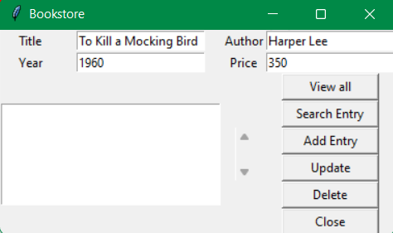
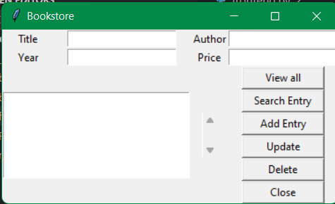
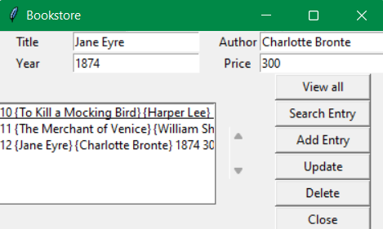

Results and Outputs
User Interface
Adding a new Entry
Viewing all the Entries

Slide 7
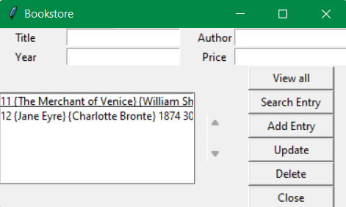
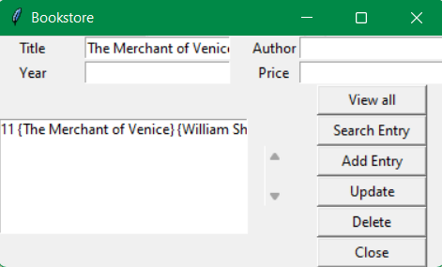
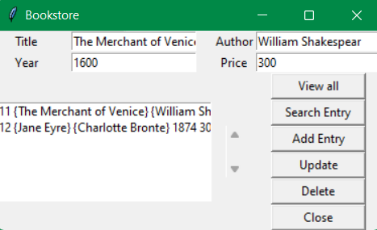
Results and Outputs
Deleting an Entry
Searching for a Saved Entry by its Name
Editing the Price of an Existing Entry

Slide 8

Conclusion
We learned how to use Tkinter – Standard Python Interface as a GUI for the front-end of the mini-project and how to apply our in class developed knowledge about python as a language in a real life helping mechanism that is our project of Book-Management-System for its backend working.
We also learned how to operate basics of SQL servers by importing its library, while trying our model for its test cases, and more of how it functions when given commands.
The algorithm and our logic application works optimally and in favor of the user while managing their book accounts.

Slide 9

References
https://docs.python.org/3/
https://www.programiz.com/python-programming
https://youtu.be/FfWpgLFMI7w
https://www.w3schools.com/python/python_intro.asp
https://docs.python.org/3/library/tkinter.html
https://www.tutorialspoint.com/python/python_gui_programming.htm
https://www.javatpoint.com/dbms-tutorial

Slide 10
Thank-You!
PS: Feel free to try out the Management System for your own self, hopefully you’ll find it helpful in managing your own share of books - https://github.com/Arya-A-Nair/Book-Management-system :))

